Slide 1
Flip flops
Flip-flops are synchronous bistable devices, also known as bistable multivibrators.
The term synchronous means that the output changes state only at a specified point (leading or trailing edge) on the triggering input called the clock (CLK), which is designated as a control input, C; that is, changes in the output occur in synchronization with the clock.
Flip-flops are edge-triggered or edge-sensitive whereas gated latches are level-sensitive.
An edge-triggered flip-flop changes state either at the positive edge (rising edge) or at the negative edge (falling edge) of the clock pulse and is sensitive to its inputs only at this transition of the clock. T

Slide 2
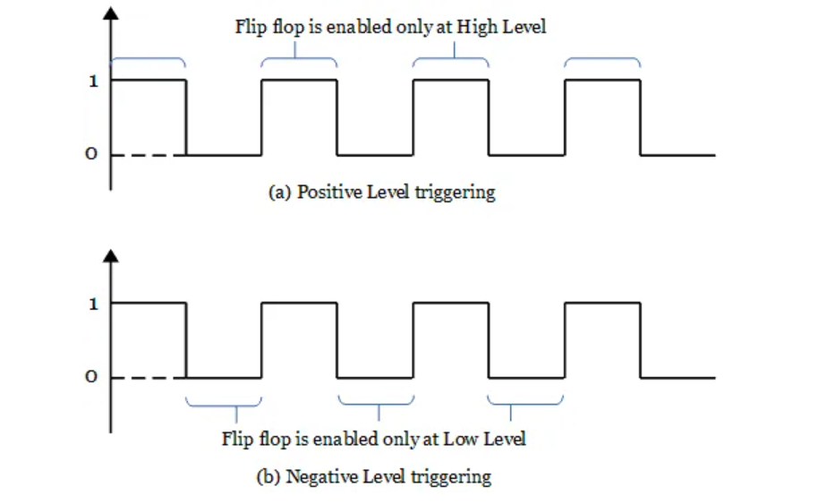
Triggering in FLIP FLOPS
Level triggering:
Positive level triggering – If the flip flop is triggered at the positive level of the clock pulse, then it is said to be a positive level triggering.
Negative level triggering – If the flip flop is triggered at the negative level of the clock pulse, then it is said to be negative level triggering.

Slide 3
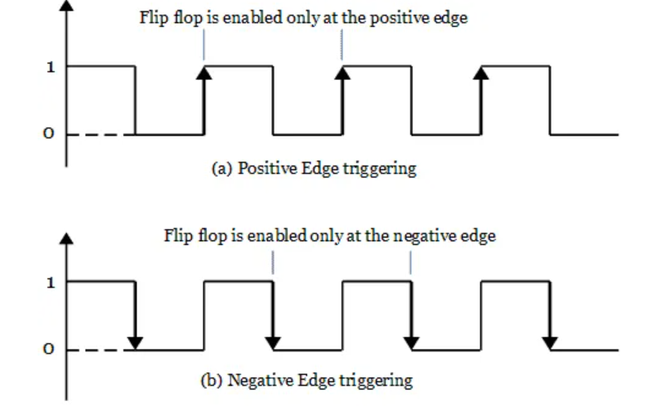
Edge triggering:
In edge triggering, the flip flop changes its state during the positive edge or negative edge of the clock pulse.
Positive edge triggering – When the output responds to the change in the input only at the positive edge of the clock pulse .
Negative edge triggering – When the output responds to the change in the input only at the negative edge of the clock pulse .

Slide 4
Clocked flip flops serve as memory elements in synchronous sequential Circuits and unclocked flip-flops (i.e., latches) serve as memory elements in asynchronous sequential circuits.
There are mainly four types of flip-flops:
JK Flip-Flop
SR (Set-Reset) Flip-Flop
Data or Delay (D) Flip-Flop
Toggle (T) Flip-Flop

Slide 5
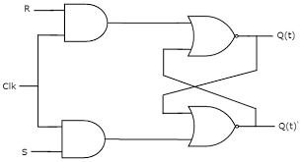
SR -LATCH WITH CLOCK SIGNAL (SR FLIPFLOP)
Q(t) | S | R | Q(t+1)
0 | 0 | 0
0 | 0 | 1
0 | 1 | 0
0 | 1 | 1
1 | 0 | 0
1 | 0 | 1
1 | 1 | 0
1 | 1 | 1
S | R | Q | Q’
0 | 0 | Hold previous | Hold previous
0 | 1 | 0 | 1
1 | 0 | 1 | 0
1 | 1 | invalid | invalid
0
0
1
x
1
0
Truth Table
1
x
SR
00
01
11
10
Characteristic table
Q(t)
0 | 0 | X | 1
1 | 0 | X | 1
Characteristic equation
Q(t+1)=S+Q(t).R’
0
1
1

Slide 6
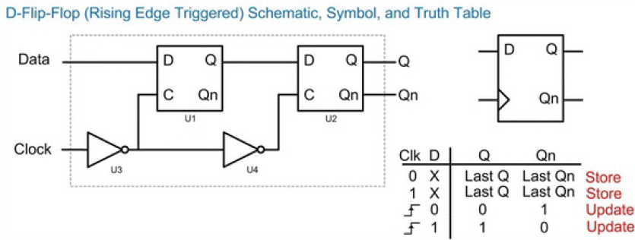
D flipflop

Slide 7
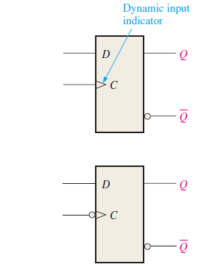
D flipflop
Most widely used storage device in sequential logic is the D-Flip-Flop.
D-Flip-Flop is similar in behavior to the D-Latch with the exception that the store mode is triggered by a transition, or edge on the clock signal instead of a level.
This allows the D-Flip-Flop to implement higher frequency systems since the outputs are updated in a shorter amount of time.
Edge-triggered flip-flop logic symbols (top: positive edge-triggered; bottom: negative edge-triggered).

Slide 8
D flipflop
Master/slave configuration because of how the data is passed through the two D-Latches (U1 and U2).
Due to the U4 inverter, the two D-Latches will always be in complementary modes. When U1 is in hold mode, U2 will be in track mode and vice versa.
When the clock signal transitions HIGH, U1 will store the last value of data. During the time when the clock is HIGH, U2 will enter track mode and pass this value to Q. In this way, the data is latched into the storage device on the rising edge of the clock and is present on Q. This is the master operation of the device because U1, or the first D-Latch, is holding the value, and the second D-Latch (the slave) is simply passing this value to the output Q.

Slide 9
D flipflop
When the clock transitions LOW, U2 will store the output of U1. Since there is a finite delay through U1, the U2 D-Latch is able to store the value before U1 fully enters track mode. U2 will drive Q for the duration of the time that the clock is LOW. This is the slave operation of the device because U2, or the second D-Latch, is holding the value.
During the time the clock is LOW, U1 is in track mode, which passes the input data to the middle of the D-Flip-Flop preparing for the next rising edge of the clock. The master / slave configuration creates a behavior where the Q output of the D-Flip-Flop is only updated with the value of D on a rising edge of the clock. At all other times, Q holds the last value of D.

Slide 10
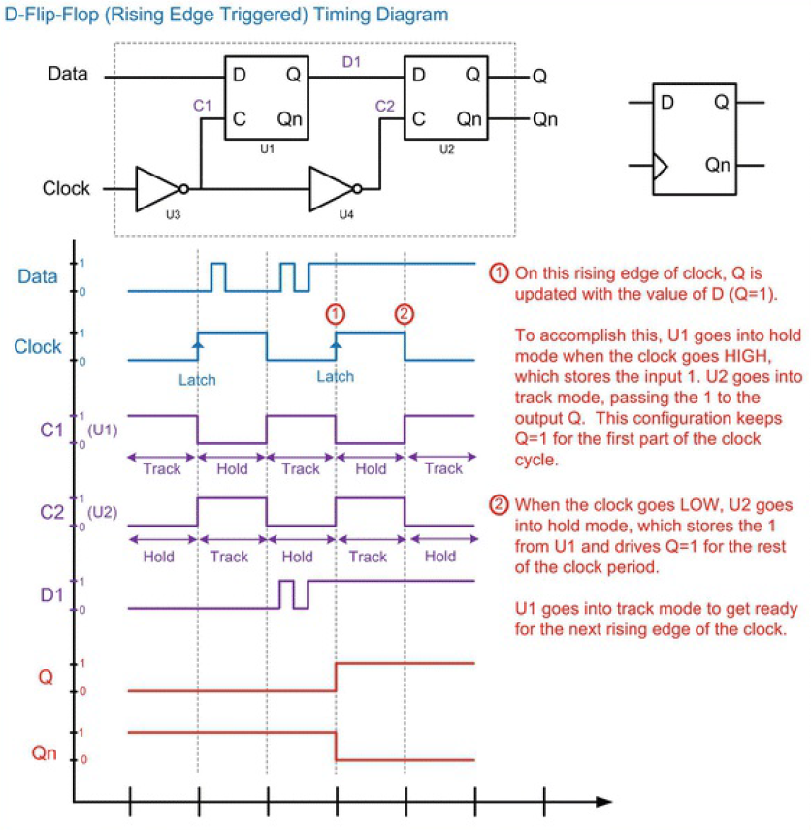

Slide 11
Asynchronous Preset and Clear Inputs
Most integrated circuit flip-flops also have asynchronous inputs.
These are inputs that affect the state of the flip-flop independent of the clock.
They are normally labeled preset(PRE) and reset(RES), clear (CLR), or direct set (SD) and direct reset (RD) by some manufacturers.
An active level on the preset input will set the flip-flop, and an active level on the clear input will reset it

Slide 12
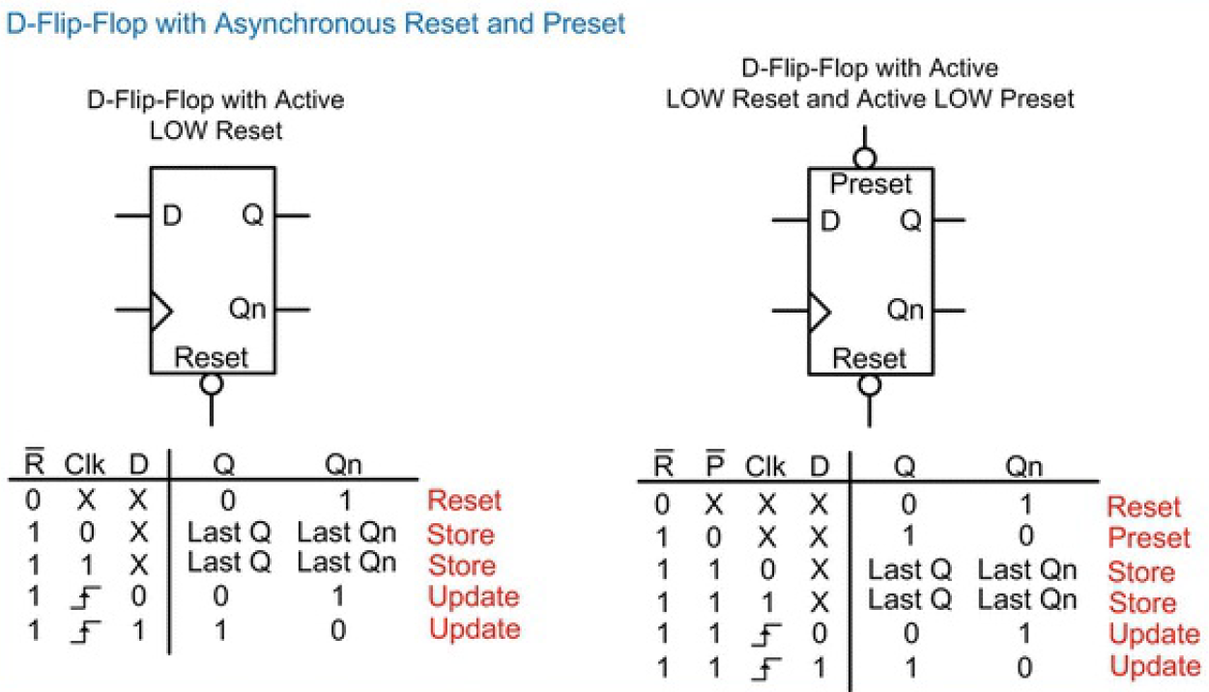

Slide 13
Resettable D flipflop
A resettable flip-flop adds another input, called RESET.
D-Flip-Flops often have additional signals that will set the initial conditions of the outputs that are separate from the clock.
A reset input is used to force the outputs to Q = 0, Qn = 1.
A preset input is used to force the outputs to Q = 1, Qn = 0.
In most modern D-Flip-Flops, these inputs are active LOW, meaning that the line is asserted when the input is a 0. Active LOW inputs are indicated by placing an inversion bubble on the input pin of the symbol. These lines are typically asynchronous, meaning that when they are asserted, action is immediately taken to alter the outputs.
This is different from a synchronous input in which action is only taken on the edge of the clock

Slide 14
Resettable flipflop
Such flip-flops may be synchronously or asynchronously resettable.
Synchronously resettable flip-flops reset themselves only on the rising edge of CLK.
Asynchronously resettable flip-flops reset themselves as soon as RESET becomes TRUE, independent of CLK.

Slide 15
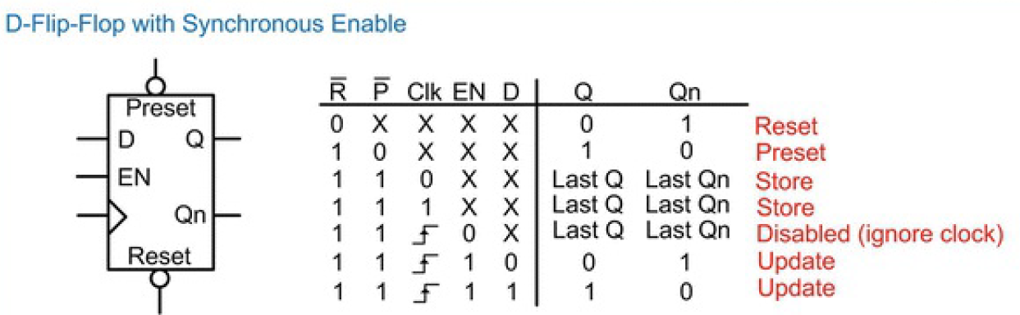

Slide 16
Enabled D-Flip-Flops
An enabled flip-flop adds another input called EN or ENABLE to determinewhether data is loaded on the clock edge.
When EN is 0, the enabled flip-flop behaves like an ordinary D flip-flop.
When EN is 1, the enabled flip-flop ignores the clock and retains its state.
An enable line controls whether or not the output is updated.
Enable lines are synchronous, meaning that when they are asserted, the outputs will be updated on the rising edge of the clock.
When de-asserted, the outputs are not updated. This behavior in effect ignores the clock input when de-asserted

Slide 17
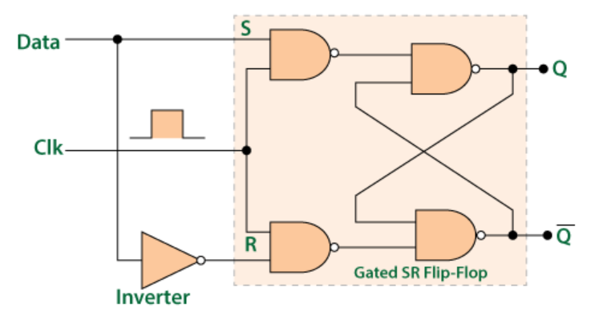
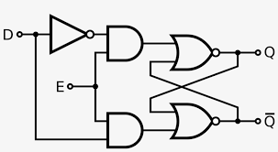
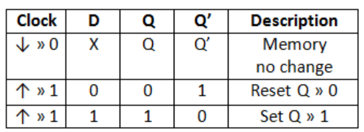
State/Truth Table for the DFlip Flop
Q(t) | D | Q(t+1)
0 | 0 | 0
0 | 1 | 1
1 | 0 | 0
1 | 1 | 1
D
0
1
Q(t)
0 | 1
0 | 1
0
Characteristic Equation for D flip flop:
Q(t+1)= D
1
Characteristic table for the D Flip Flop

Slide 18
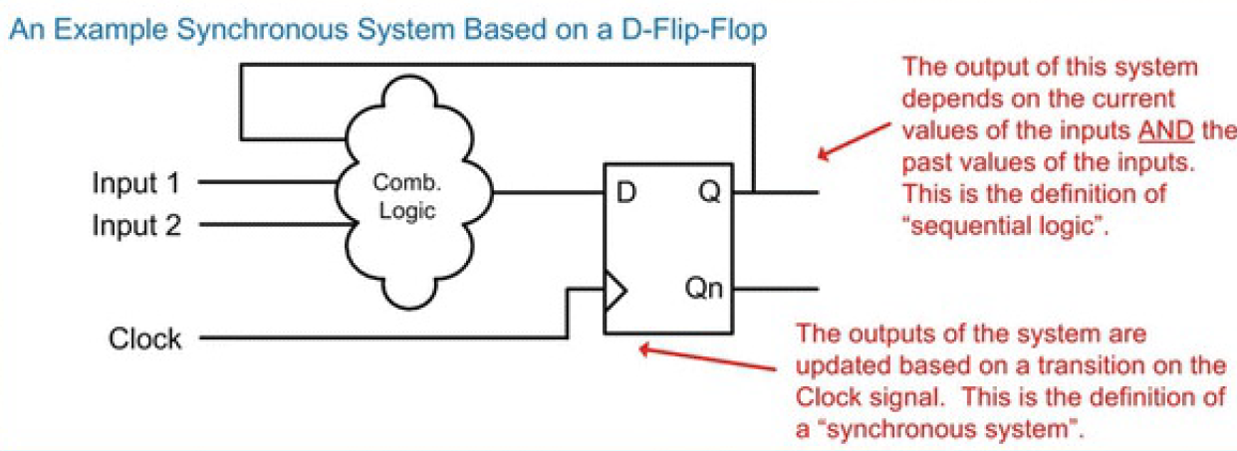

Slide 19
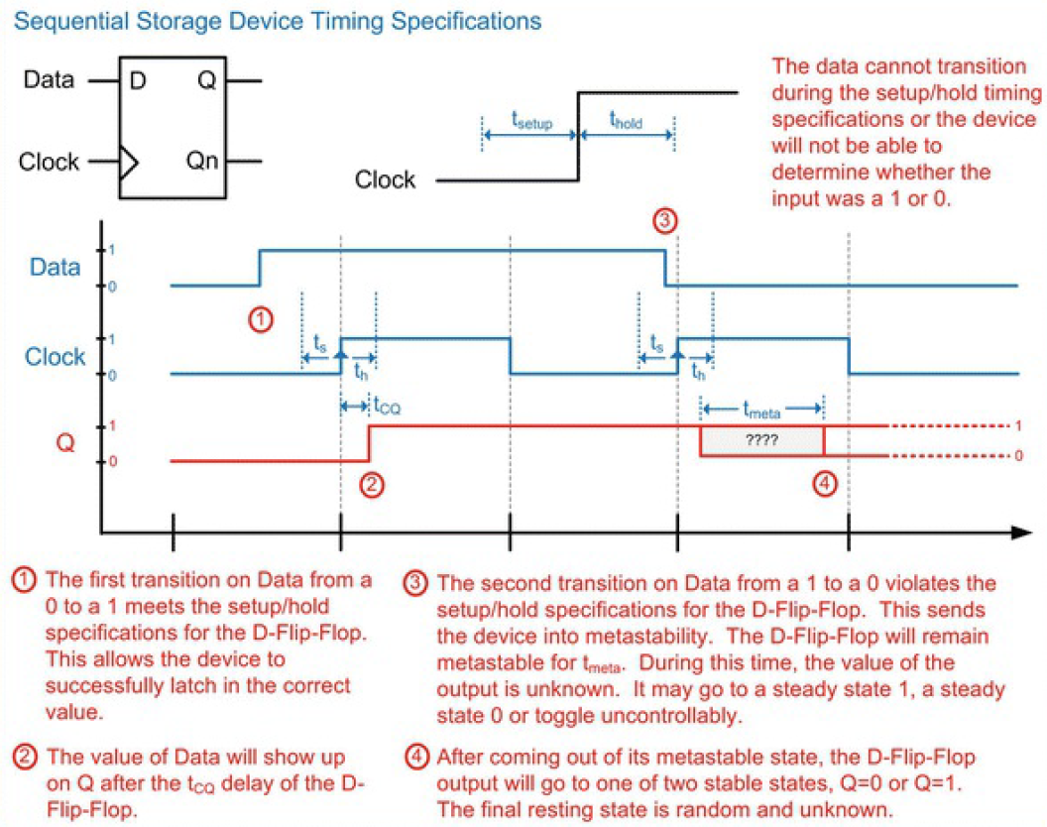

Slide 20
Sequential logic timing considerations
There are a variety of timing specifications that need to be met in order to successfully design circuits using sequential storage devices.
Setup time (tsetup or ts) ➔ specifies how long the data input needs to be at a steady state before the clock event.
Hold time (thold or th) ➔ specifies how long the data input needs to be at a steady state after the clock event
If these specifications are violated (i.e., the input transitions too close to the clock transition), the storage device will not be able to determine whether the input was a 1 or 0 and will go metastable. The time a storage device will remain metastable is a deterministic value and is specified by the part manufacturer (tmeta).

Slide 21
Sequential logic timing considerations
Metastability should be avoided; but knowing the maximum duration of metastability for a storage device allows us to design circuits to overcome potential metastable conditions.
During the time the device is metastable, the output will have random behavior. It may go to a steady state 1, a steady state 0, or toggle between a 0 and 1 uncontrollably.
Once the device comes out of metastability, it will come to rest in one of its two stable states (Q = 0 or Q = 1). The final resting state is random and unknown.
Clock-to-Q delay (tCQ ) ➔ delay from the time a clock transition occurs to the point that the data is present on the Q output

